Slide 1



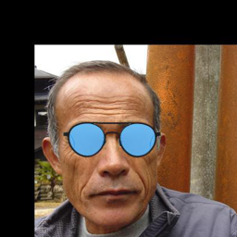
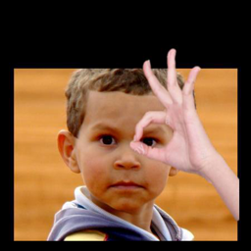

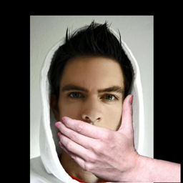
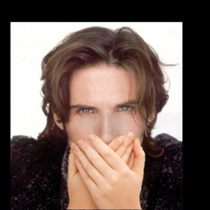

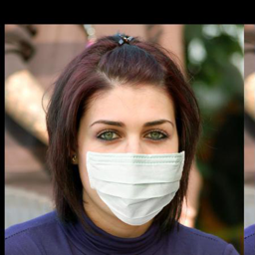
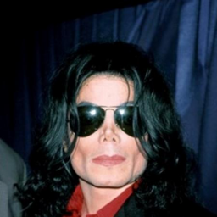
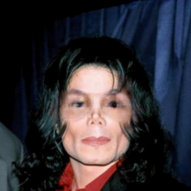

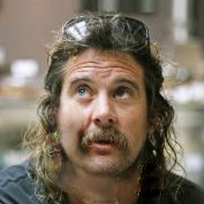
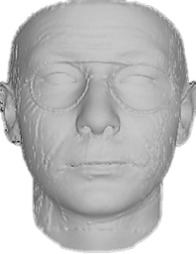
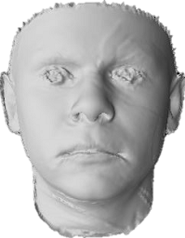
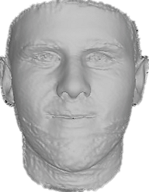
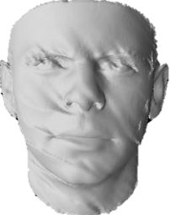
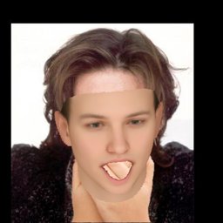

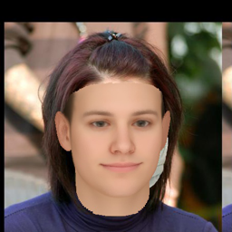
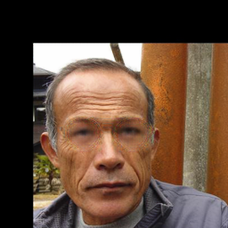
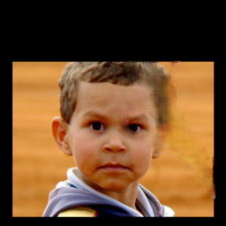
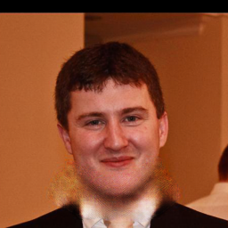
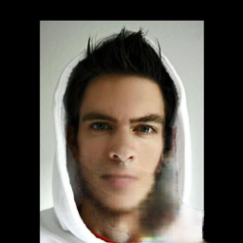
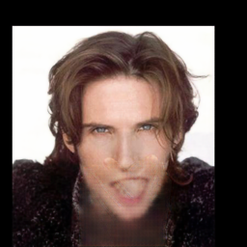
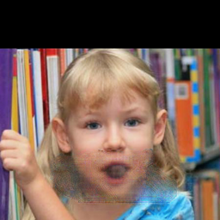
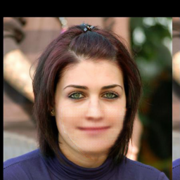
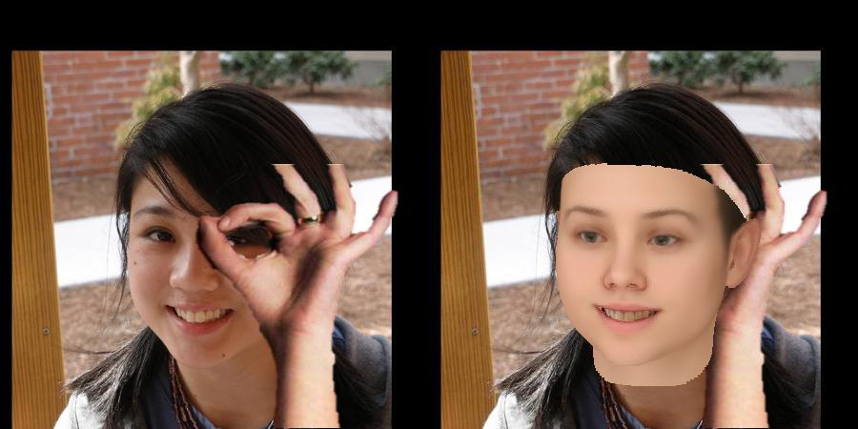
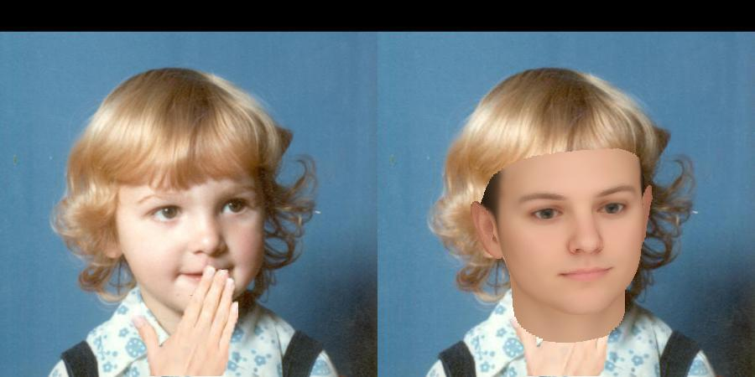
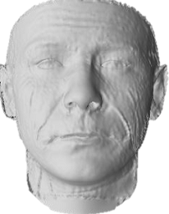
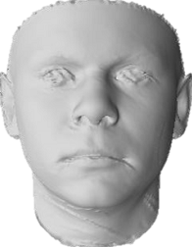
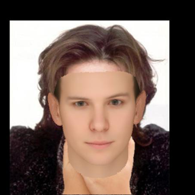

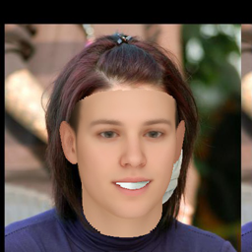
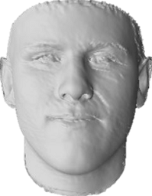
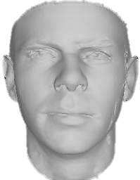
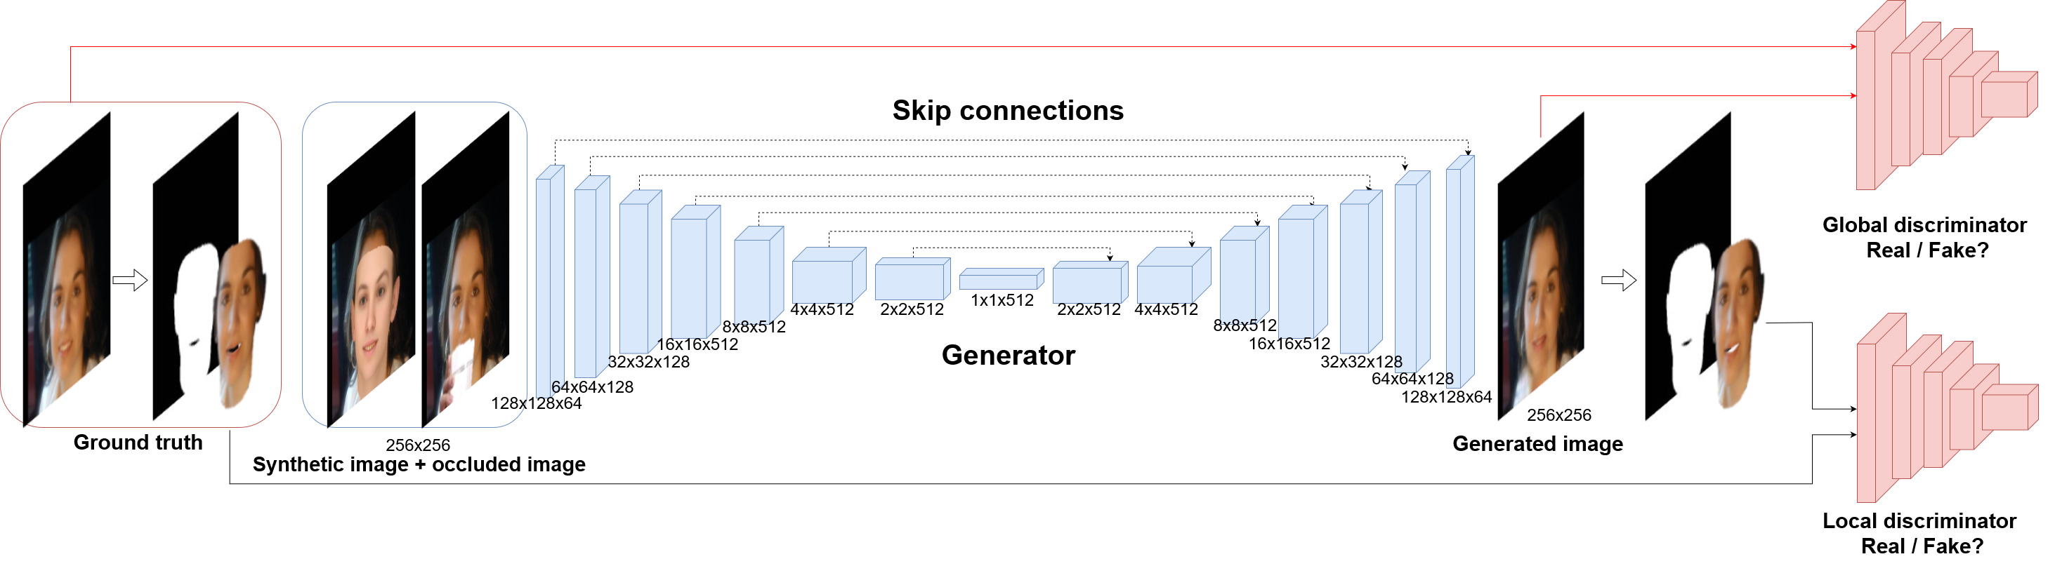
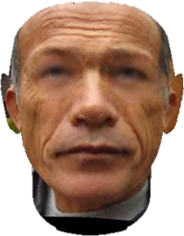
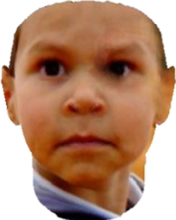
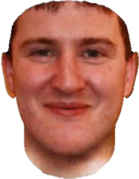
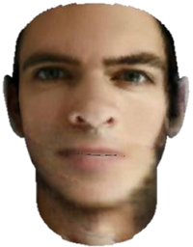
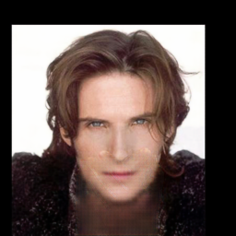



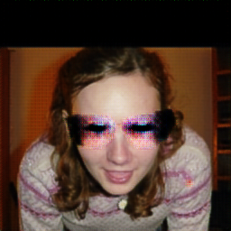
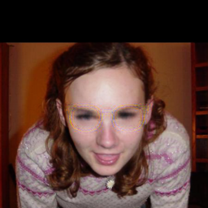
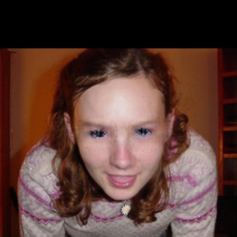
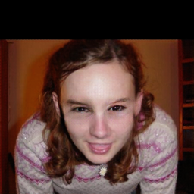
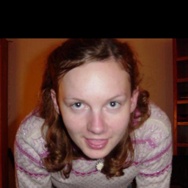
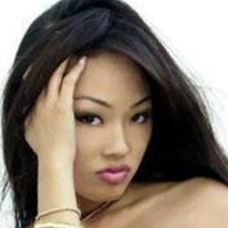
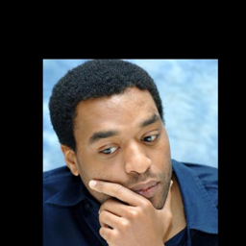
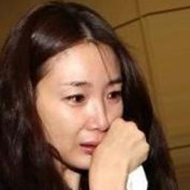

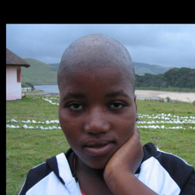
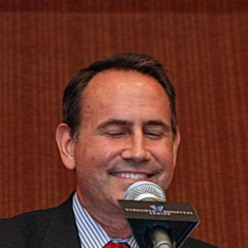


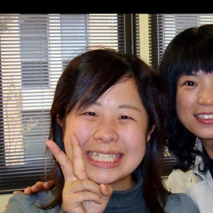

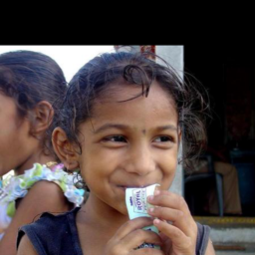
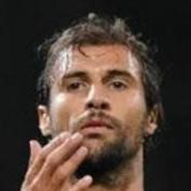
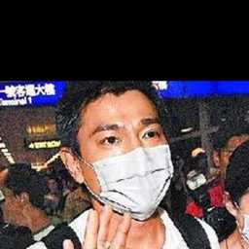
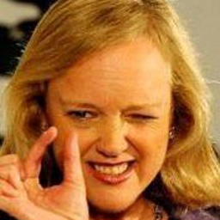




























Face De-occlusion using 3D Morphable Model and Generative Adversarial Network
Xiaowei Yuan^{1, 2} In Kyu Park¹
{xiaoweichn@qq.com, pik@inha.ac.kr}
¹Dept. of Information and Communication Engineering, Inha University, Incheon 22212, Korea
²Zhuiyi Technology, Shenzhen, China
INTRODUCTION
PROPOSED FACE DE-OCCLUSION ALGORITHM
EXPERIMENTAL RESULT AND APPLICATIONS
Problem Statement
Given an occluded facial image, generate an occlusion-free image
3D Morphable Model (3DMM) [1]
Bi-linear face model which defines face shape and expression
$M\left(α,β\right)={\overline{S}}_{id}+α×S_{id}+β×S_{exp}$
Synthesis is depend on 3DMM parameters and weak perspective projection
Face De-occlusion Network
Consisting of a generator, a global discriminator and a local discriminator
$L=λ_{1}L_{gen}+λ_{2}L_{tv}+$ $λ_{3}L_{adv_g}+$ $λ_{4}L_{adv_l}$
3DMM provides the geometric prior and face mask for the local discriminator.
Training Dataset
134,233 augmented training samples from 300W-3D, AFLW2000-3D
Each training sample:
3DMM synthesis
Occluded image
corresponding occlusion-free image
Pipeline of Proposed Algorithm
3D Face Reconstruction
Face Editing
Occluded Image
Occluded Image
Face Reconstruction
3DMM Synthesis
Challenge
Restoring the occluded region while handling the illumination and pose variation
Difficult to collect occluded face images with their corresponding occlusion-free images
$L_{1}$ Loss
Smooth Term
Adversarial Loss [2]
De-occluded image
De-occluded Image
CONTRIBUTION
Face Reconstruction
3DMM Synthesis
A 3DMM-conditioned GAN framework to remove face occlusion
Restore the occluded region without any prior occluder mask
De-occlusion on RGB images with various head poses and illumination
Handle challenging types of occlusions at any position
Build a large-scale synthesized face-with-occlusion dataset
Texture Mapping
De-occluded Image
REFERENCES
Ablation Study
[1] V. Blanz and T. Vetter. A morphable model for the synthesis of 3D faces. In Proc. of the 26th Annual Conference on Computer
Graphics and Interactive Techniques, pages 187–194, 1999
[2] I. Goodfellow, J. Pouget-Abadie, M. Mirza, B. Xu, D. Warde-Farley, S. Ozair, A. Courville, and Y. Bengio. Generative adversarial nets. In
Proc. Advances in Neural Information Processing Systems, pages 2672–2680. 2014
From left to right:
Occluded face image
Remove 3DMM synthesis
Remove all discriminators
Remove local discriminator
Our de-occlusion result
Ground truth
Occluded Image
De-occlusion Result

